Slide 1

A look at…….
Jason Simpson

Slide 2

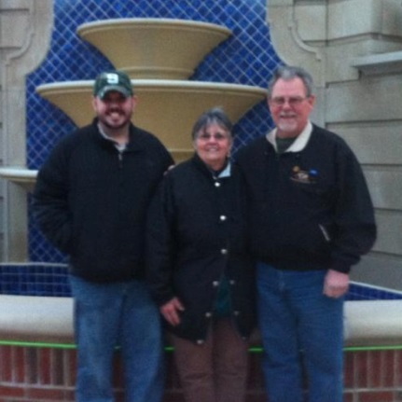

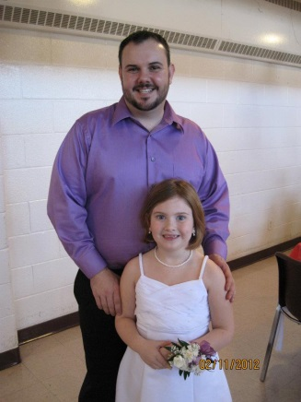
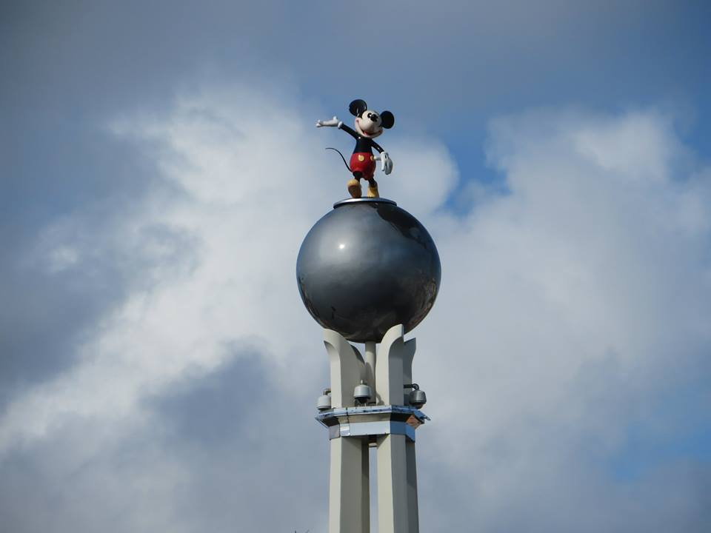
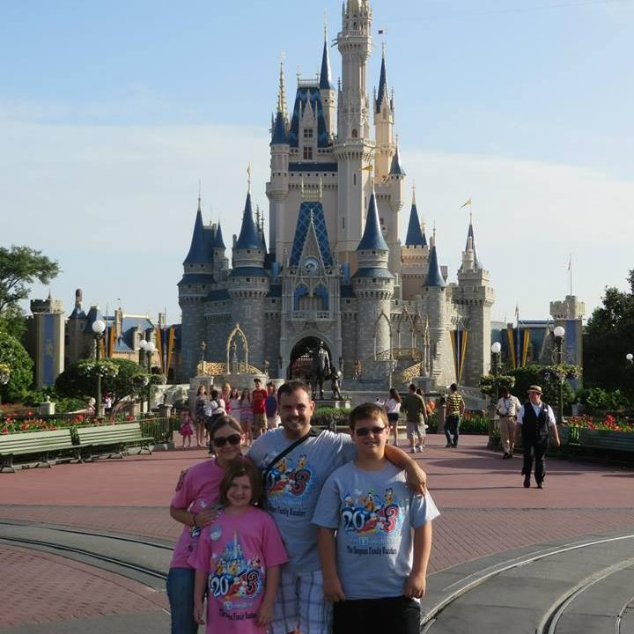
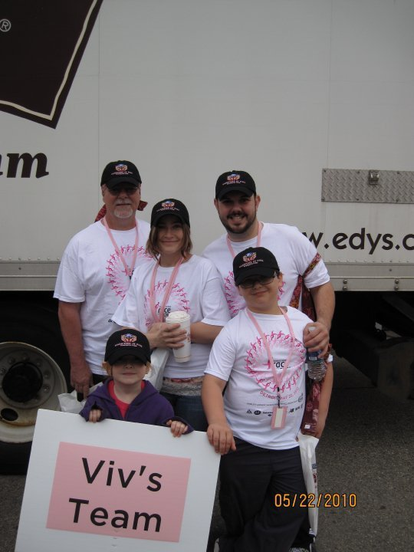
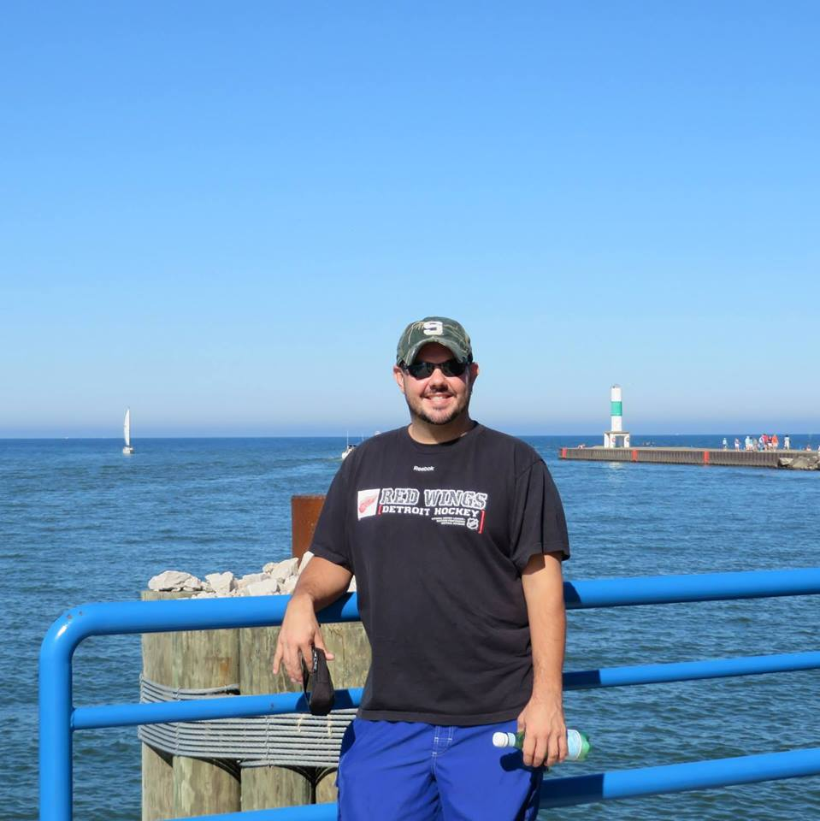
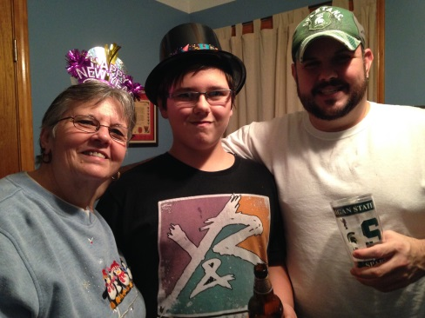
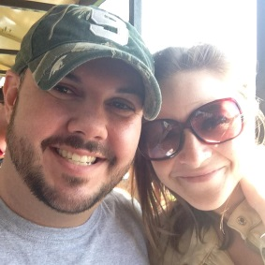
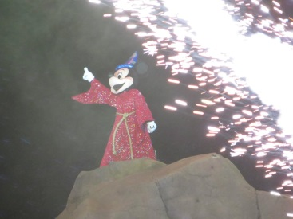
Hello my name is Jason Simpson. I was born and raised in Southgate, Michigan. I currently live in Lincoln Park, MI with my wife and two kids. In my spare time I love to travel with my family.

Slide 3
My Family ……………..

Slide 4

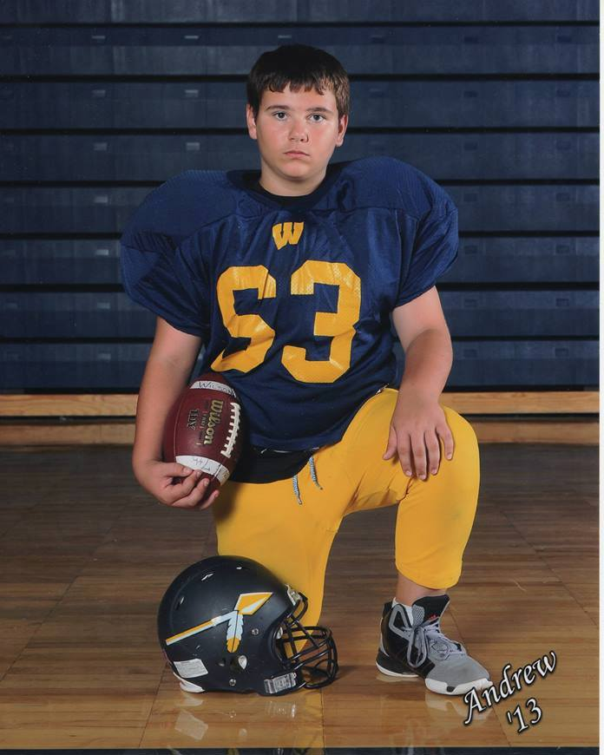
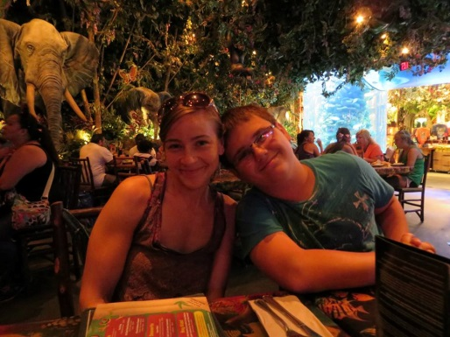
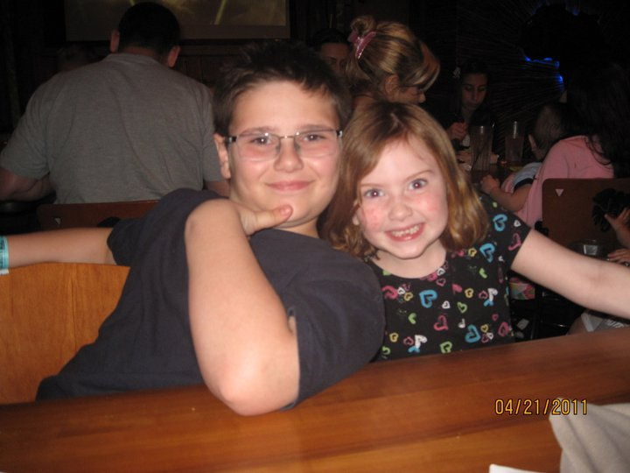
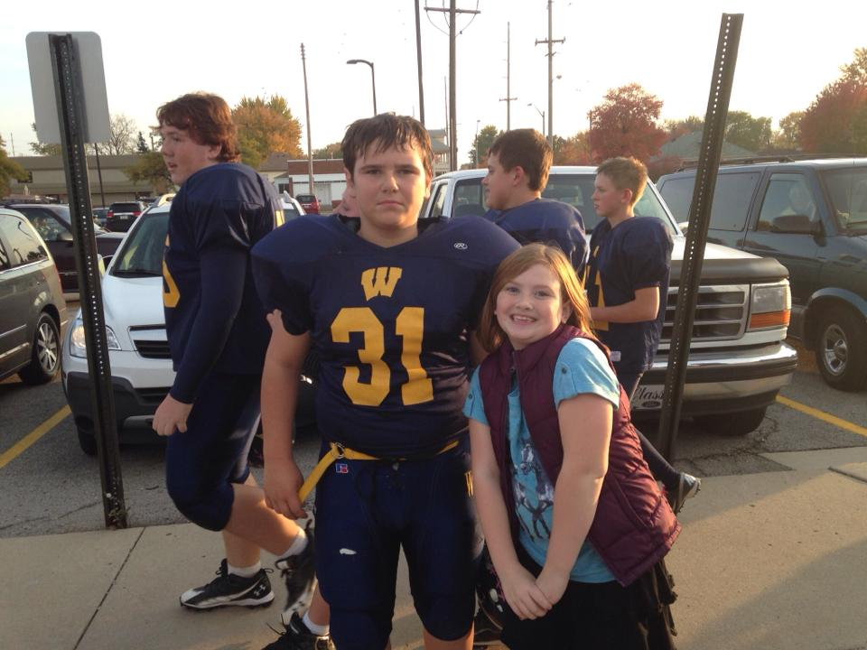
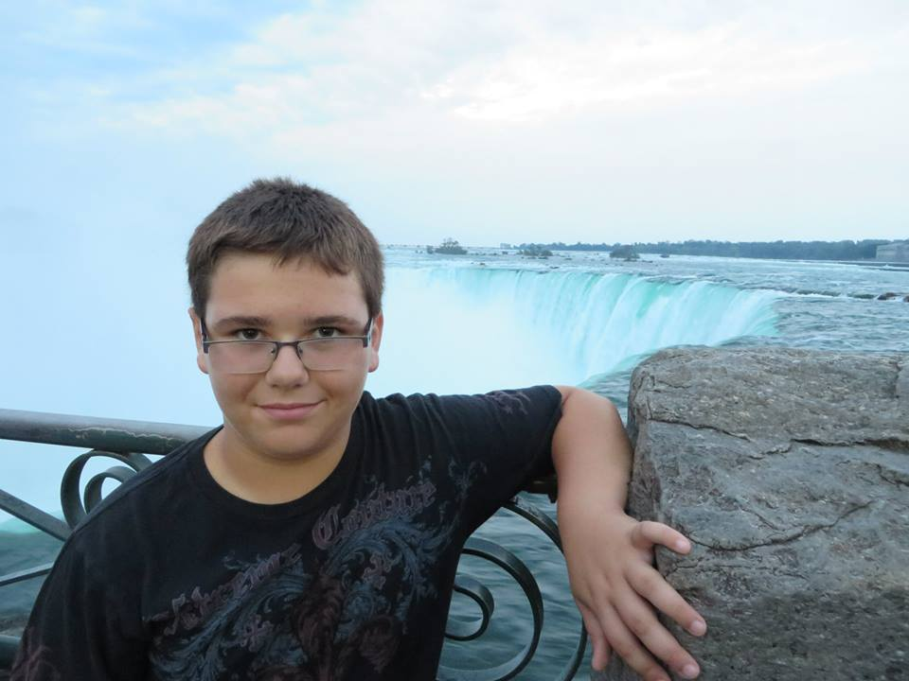
My son Andrew is thirteen years old and enjoys playing football.

Slide 5
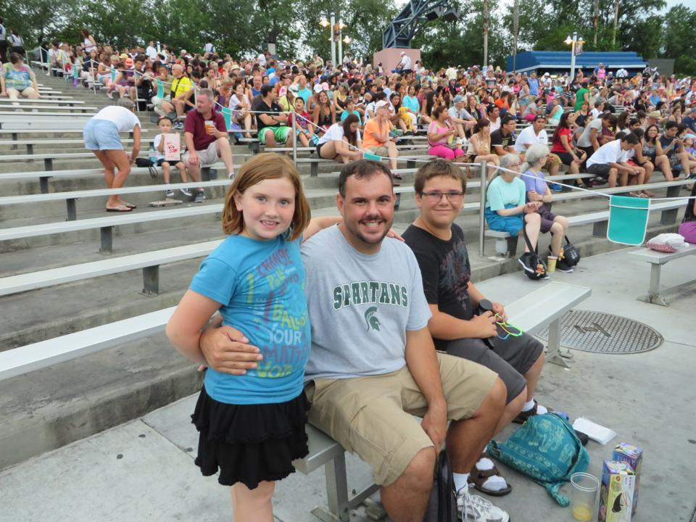
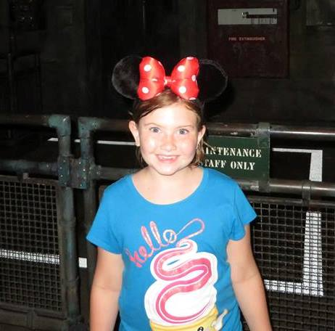
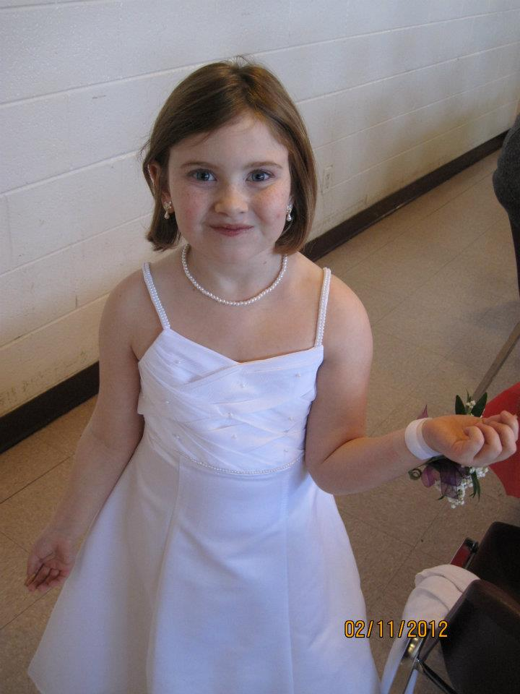
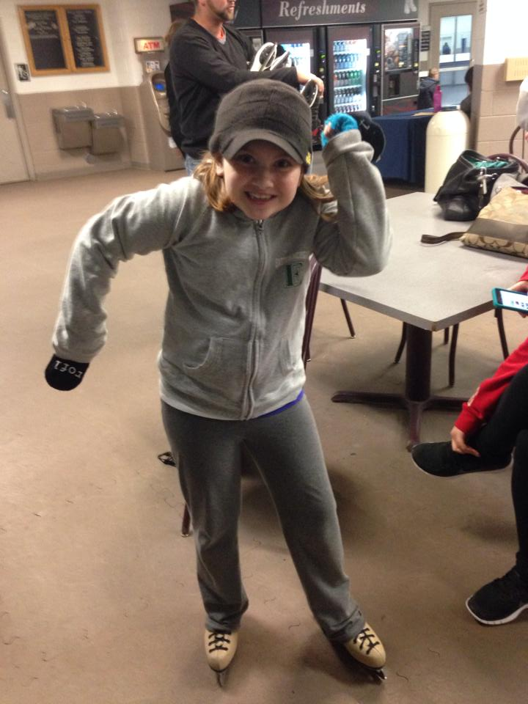
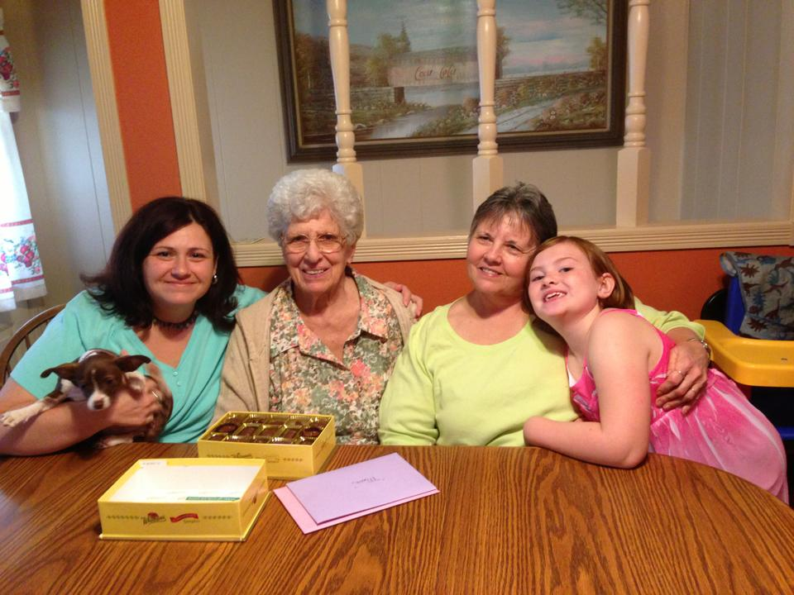

My daughter Emma is nine years old. She loves to ice skate and is a true Spartans Fan!

Slide 6
My Education …........

Slide 7
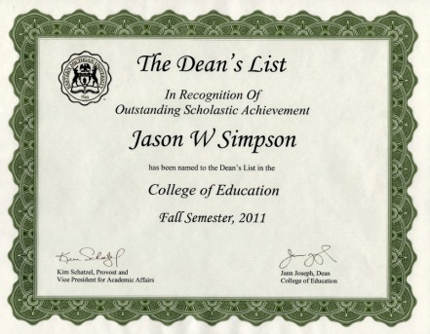



I graduated from Southgate Anderson High School in Southgate Michigan. I then received my B.A. in Special Education Teaching from Eastern Michigan University. I am currently striving to complete my M.A in Educational Technology from Michigan State University.

Slide 8

TE 846 …………
Accommodating Differences in Literacy Learners.
After completing this class I hope to have learned new strategies and skills to help my struggling readers. I want to learn new ways to allow all learners to be able to access grade level appropriate materials. To be able to build the skills they need to succeed in their educational journeys.

Slide 9
My Career …………..

Slide 10
I am a special education teacher that teaches first through fourth graders. My day is split between two elementary school resource rooms. I have nineteen students on my caseload. Before I went into teaching I worked as a Network Administrator for a school district for thirteen years. It was while working in the school district that I was inspired by the wonderful teachers around me to go into teaching.

Slide 11
My Classrooms . . . . . . . . . .
Monday through Friday, for the first part of my day, I am working in my Resource Room at Monroe Elementary School. For the second part of my day, I am working in my Resource Room at Jefferson Elementary School. While in the resource room, the students work on reading, writing, and math. The activities are reflective of what is being worked on in the classroom and their individual goals and needs. My literacy challenges are in building reading fluency skills, and phonics skills with my students. I try to implement as much technology into my lessons as possible. Whenever technology is involved my students are eager to learn and stay engaged throughout the lessons.

Slide 12
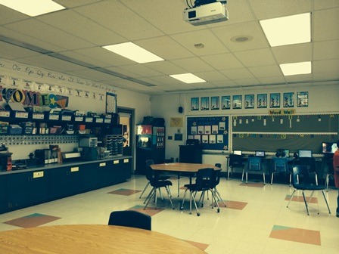
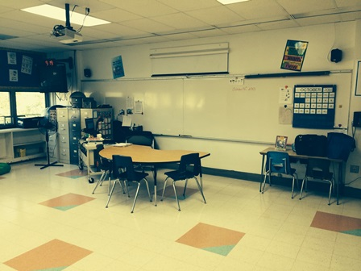
Monroe Elementary Classroom

Slide 13
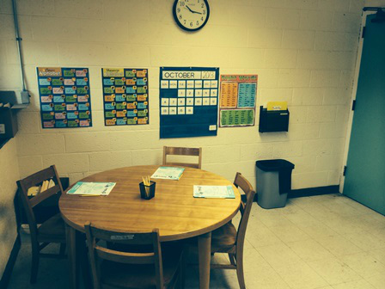
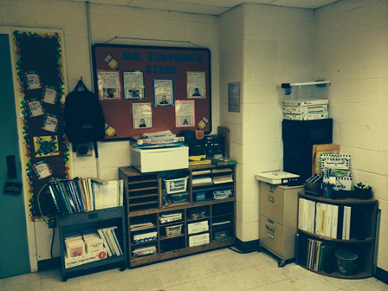
Jefferson Elementary Classroom

